Slide 1
Chi-Square Test of Independence in R (With Examples)
A Chi-Square Test of Independence is used to determine whether or not there is a significant association between categorical variables.

Slide 2
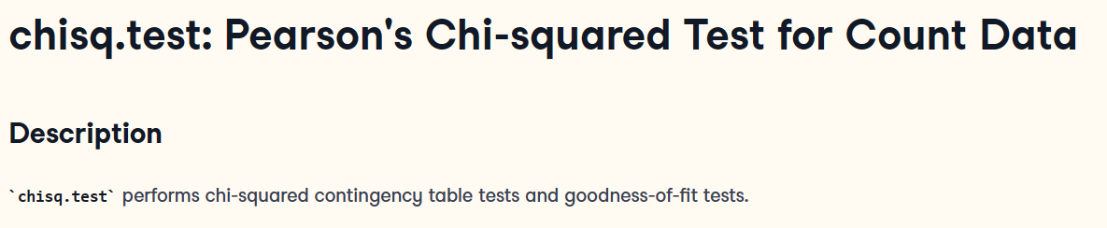
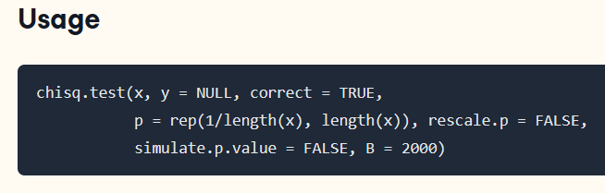

Slide 3
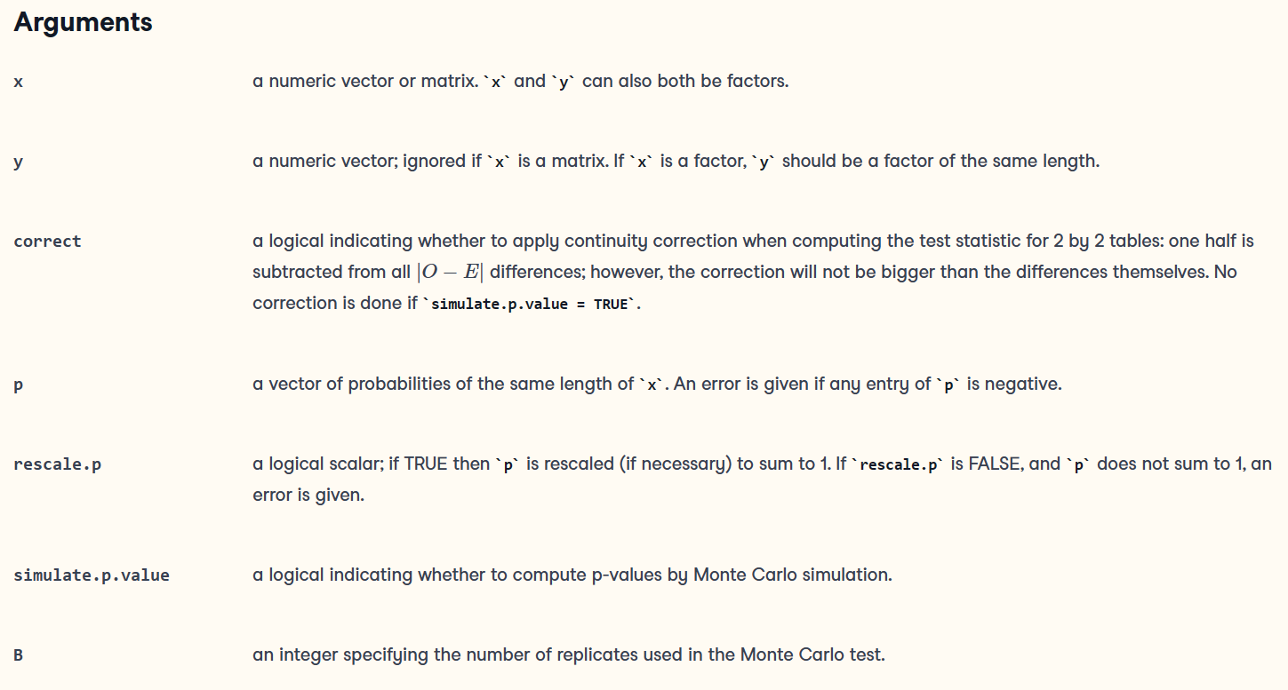

Slide 4
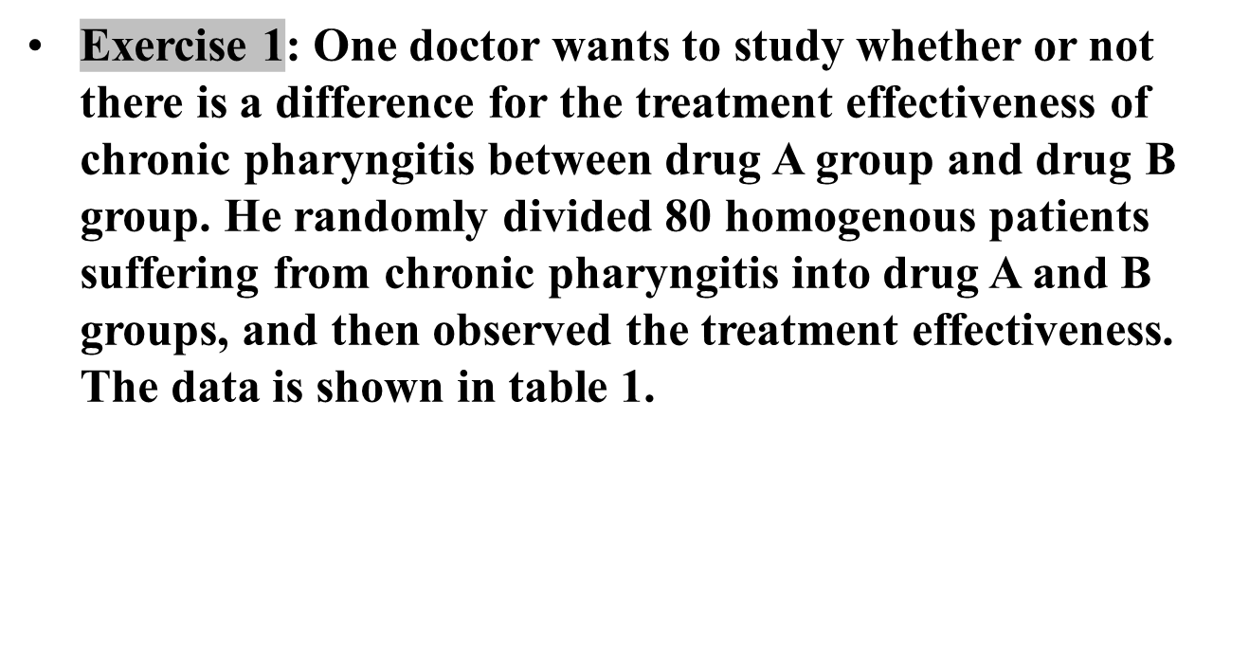
Table 1 Data of effect treated by drug A and drug B
Drug group | effective
 | yes | no
A | 41 | 4
B | 24 | 11
Notes:
/ˌfærɪnˈdʒaɪtɪs/
Let p1 = the probability of effective in group A and p2 = the probability of effecitive in group B. The question is whether the underlying probability Π is different in the two groups.

Slide 5
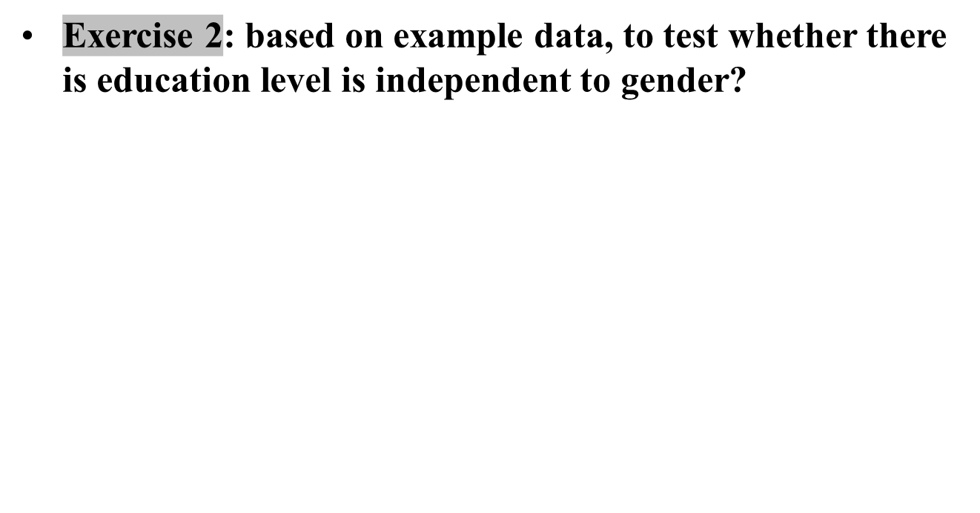
Notes:
/ˌfærɪnˈdʒaɪtɪs/
Let p1 = the probability of effective in group A and p2 = the probability of effecitive in group B. The question is whether the underlying probability Π is different in the two groups.

Slide 6
Fisher’s Exact Test
Fisher’s Exact Test is used to determine whether or not there is a significant association between two categorical variables. It is typically used as an alternative to the Chi-Square Test of Independence when one or more of the cell counts in a 2×2 table is less than 5.

Slide 7
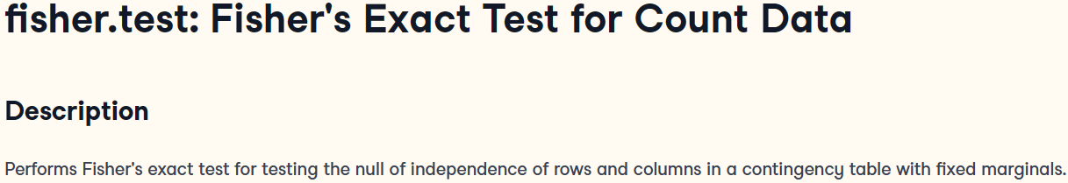
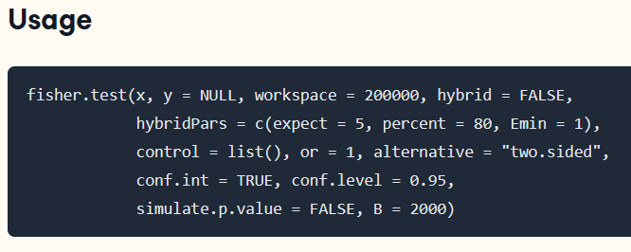

Slide 8
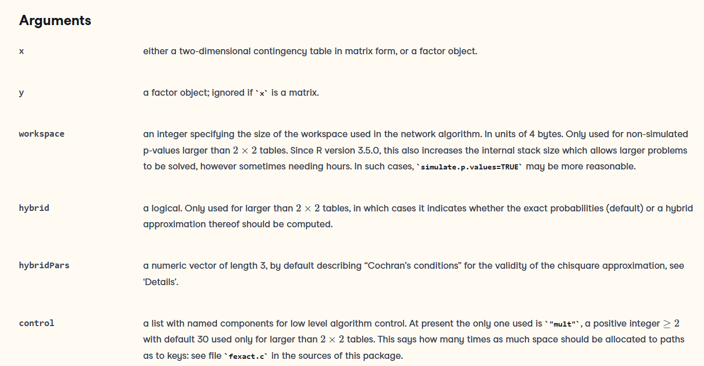

Slide 9

➢When any of theoretical value is less than 1(T<1) or n<40, we need to use fisher’s exact method to estimate the P value and make the statistical inference.
➢We can use R, SPSS or SAS to get the P value.
Table 5 Comparison of mouse death rate for poison A and B
Poison group | Death outcome |  | total | Rate of death(%)
 | Yes | No
A | 1 | 9 | 10 | 10.0
B | 5 | 5 | 10 | 50.0
Total | 6 | 14 | 20 | 30.0

Slide 10
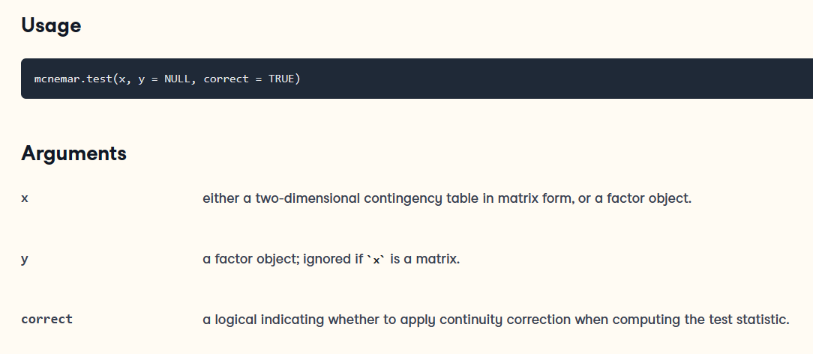
McNemar's Chi-squared Test for Count Data

Slide 11

Standard test | New test |  | total
 | + | -
+ | 82(a) | 5(b) | 87
- | 10(c) | 3(d) | 13
total | 92 | 8 | 100

Slide 12

Cohen’s Kappa is used to measure the level of agreement between two raters or judges who each classify items into mutually exclusive categories.
The easiest way to calculate Cohen’s Kappa in R is by using the cohen.kappa() function from the psych package, or kappa() function form the vcd package.

